Slide 1
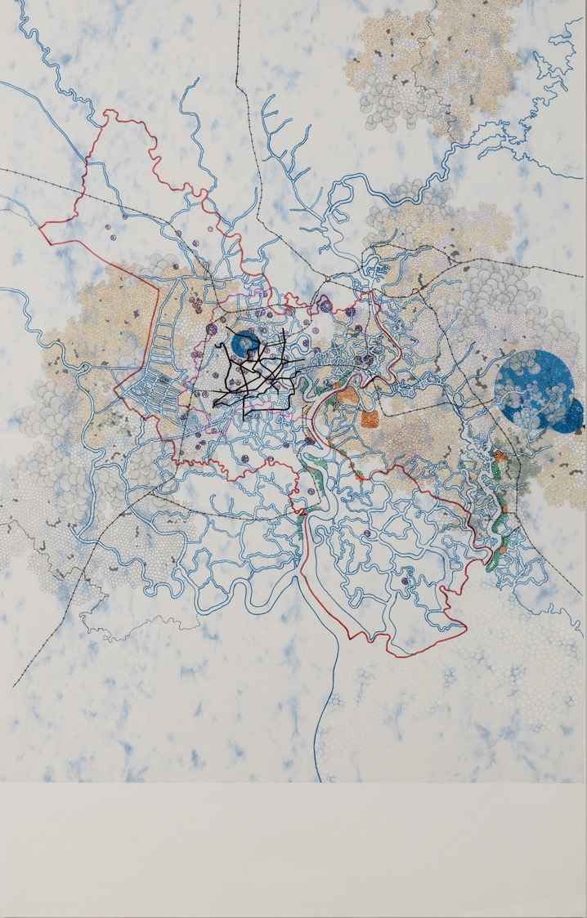
Notes:
Tiffany Chung’s Flora and Fauna Outgrowing the Future

Slide 2
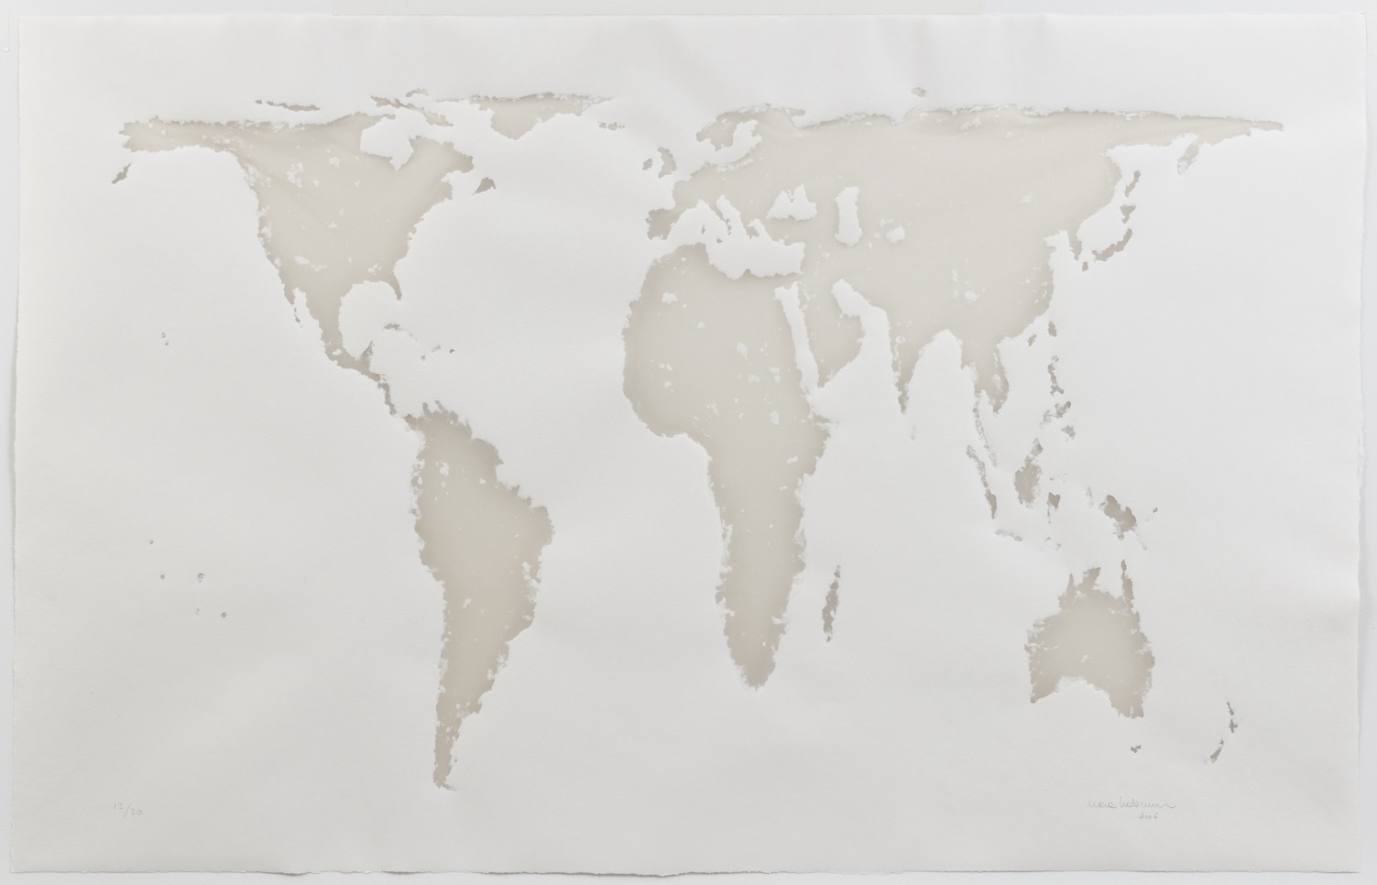
Notes:
Mona Hatoum’s Projection

